Slide 1
Rich Internet Application
Module 6

Slide 2
Rich Internet applications (RIA) are Web-based applications that have some characteristics of graphical desktop applications.
Built with powerful development tools, RIAs can run faster and be more engaging.
They can offer users a better visual experience and more interactivity than traditional browser applications that use only HTML and HTTP.
RIAs typically leverage advanced web technologies such as AJAX (Asynchronous JavaScript and XML), HTML5, CSS3, and JavaScript to provide features like interactivity, responsiveness, multimedia content, and offline capabilities.
Notes:
https://www.computerworld.com/article/2551058/rich-internet-applications.html

Slide 3
The term "rich Internet application" was introduced in a white paper of March 2002 by Macromedia (later merged into Adobe)
Rich Internet Applications use a Rich Client deployment model rather than a thin-client-server model

Slide 4
How are web applications different from traditional desktop applications?
Web Application
Standalone
Application
Client
Computer
Interface
Interface
HTTP
Controller / Business Logic
Server
Controller / Business Logic
Data
Data

Slide 5
Web Application
Web Applications
Client
Interface
HTTP
Server
Controller / Business Logic
Data

Slide 6
Characteristics of Rich Internet Applications include:
Interactivity: RIAs allow users to interact with the application in real-time without needing to reload the entire webpage. This enables features like drag-and-drop, dynamic content updates, and form validation without page refreshes.
Rich Media: RIAs can incorporate rich media elements such as audio, video, animations, and graphics to enhance the user experience and engagement.
Asynchronous Data Loading: RIAs use techniques like AJAX to fetch data from the server asynchronously, enabling faster response times and a smoother user experience by updating only the necessary parts of the page.
Cross-Platform Compatibility: RIAs are designed to run on multiple platforms and devices, including desktop computers, laptops, tablets, and smartphones, without requiring platform-specific development.

Slide 7
Responsive Design: RIAs can adapt to different screen sizes and orientations, providing a consistent user experience across devices through responsive design principles.
Offline Capabilities: Some RIAs can continue to function even when the user is offline by leveraging technologies like local storage and caching. This allows users to access certain features and content without an active internet connection.
Client-Side Processing: RIAs offload some processing tasks from the server to the client's browser, improving performance and reducing server load. This is often achieved using client-side scripting languages like JavaScript.
Integration with Web Services: RIAs seamlessly integrate with web services and APIs to access and manipulate data from external sources, enabling features like social media integration, real-time updates, and third-party content embedding.

Slide 8
Security: RIAs incorporate security features to protect user data and prevent unauthorized access, including encryption, secure communication protocols, input validation, and authentication mechanisms.

Slide 9
At the client's end
A controlled and standardized environment for running the client portion of a web application
Support richer UI and interaction
For the developers
Improving productivity
No need to worry about browser's incompatibilities
Build UI the same way UIs are built for stand-alone applications (familiarity)
Build UI using visual tools
Ability to use other languages to write scripts to interact with UI components

Slide 10
PROs
Installation is not required
Easy to upgrade
Easily made available over internet/intranet
Richer UI
More responsive UI
Client/Server Balance
Asynchronous communication
Network efficiency
CONs
Loss of visibility to search engines
Software development complications (What to cache or not to cache at client's computer?)
RIA architecture breaks the Web page paradigm

Slide 11
AJAX

Slide 12
stands for Asynchronous Javascript And XML
Allows incremental update of Web pages.
Built using standard web technologies - HTTP, (X)HTML, CSS, JavaScript, Document Object Model (DOM), XML
created by Jesse James Garrett in 2005.
Ajax isn’t a single technology.
It’s really several independent technologies coming together in new ways.
Ajax incorporates:
standards based presentation using XHTML and CSS
dynamic display and interaction using the Document Object Model
data interchange and manipulation using XML and XSLT
asynchronous data retrieval using XMLHttpRequest
JavaScript binding everything together

Slide 13
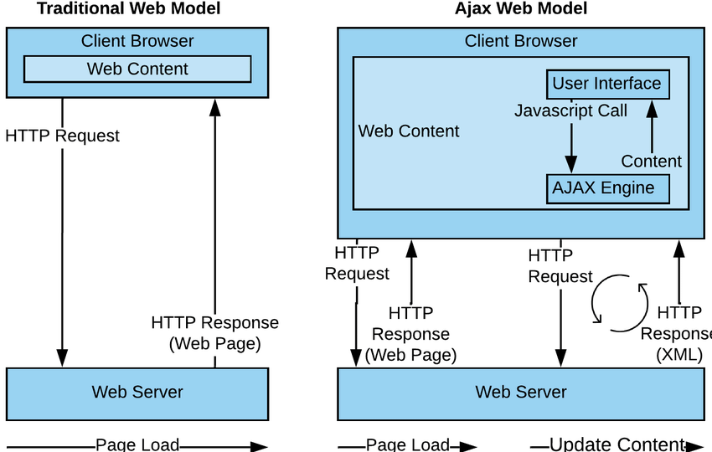

Slide 14
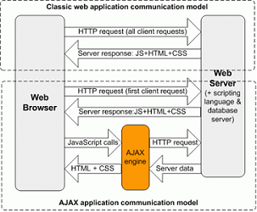

Slide 15
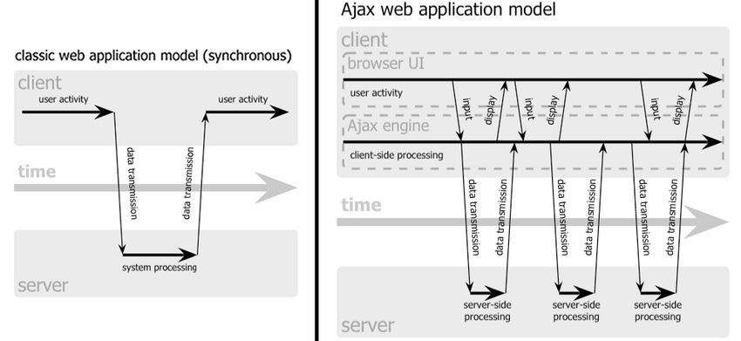

Slide 16
How does AJAX work?
A JavaScript creates an XMLHttpRequest object, initializes it with relevant information as necessary, and sends it to the server. The script (or web page) can continue after sending it to the server.
The server responds by sending the contents of a file or the output of a server side program (for example, in PHP).
When the response arrives from the server, a JavaScript function is triggered to act on the data supplied by the server.
This JavaScript response function typically refreshes the display using the DOM, avoiding the requirement to reload or refresh the entire page.

Slide 17
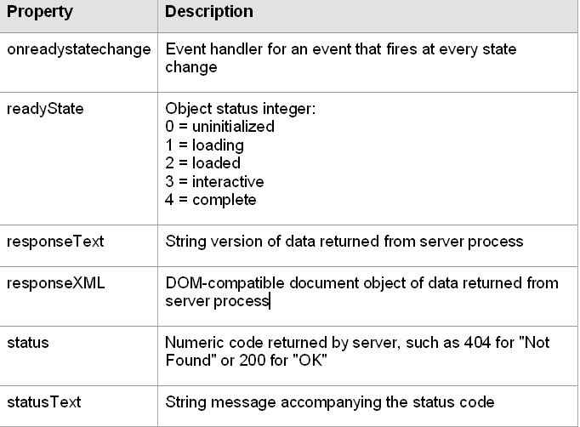

Slide 18
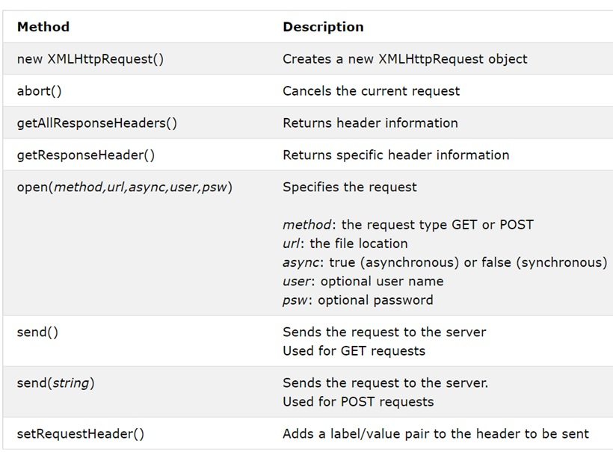

Slide 19
What are the Issues with AJAX?
User does not know updates will occur.
User does not notice an update.
User can not find the updated information.
Unexpected changes in focus.
Loss of Back button functionality*.
URIs can not be bookmarked*.

